Slide 1
Digital Portfolio
STUDENT NAME: VALARMATHI A
REGISTER NO AND NMID: 8B12DEA9F7DC01D8C7A4F288E2E3A39E
DEPARTMENT: BCA
COLLEGE:SRIMATH SIVAGNANA BALAYA SWAMIGAL TAMIL ,ARTS SCIENCE COLLEGE, MAILAM
UNIVERSITY:ANNAMALAI UNIVERSITY

Slide 2
PROJECT TITLE INNOVATIVE CREATIONS

Slide 3


AGENDA
Problem Statement
Project Overview
End Users
Tools and Technologies
Portfolio design and Layout
Features and Functionality
Results and Screenshots
Conclusion
Github Link
3/21/2024 Annual Review

Slide 4

PROBLEM STATEMENT
"Existing system lacks efficiency and user-friendliness, leading to time consumption and errors. Our project aims to provide a simple and effective solution."

Slide 5

PROJECT OVERVIEW
"This project focuses on providing an efficient and user-friendly solution that simplifies processes, saves time, and improves overall productivity."

Slide 6

WHO ARE THE END USERS?
Individuals or organizations who directly benefit from the system.They will use the solution to simplify tasks, save time, and improve efficiency.

Slide 7

TOOLS AND TECHNIQUES
Work efficiency improve panna help pannumProblem-solving easy aagumProductivity increase aagumCreative solutions provide pannum

Slide 8
POTFOLIO DESIGN AND LAYOUT
Creates first impressionDefines visual structureEnhances readabilityShowcases creativity & professionalism
8

Slide 9
FEATURES AND FUNCTIONALITY
"Features describe what a product has, while functionality explains what it can do. Features are the characteristics, and functionality is the practical use or purpose."

Slide 10
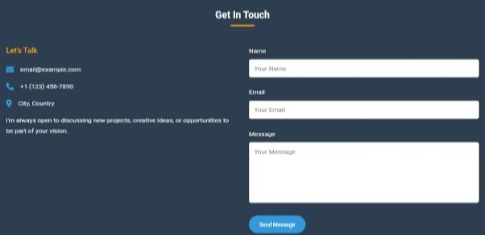


RESULTS AND SCREENSHOTS
Demonstrates project outcome.
Provides visual proof.
Shows accuracy and efficiency.
Easy to understand output
3/21/2024 Annual Review
10

Slide 11
CONCLUSION
Developed new and impactful ideasCombined creativity with technologyEnsures practical use and future growth
11

